Slide 1
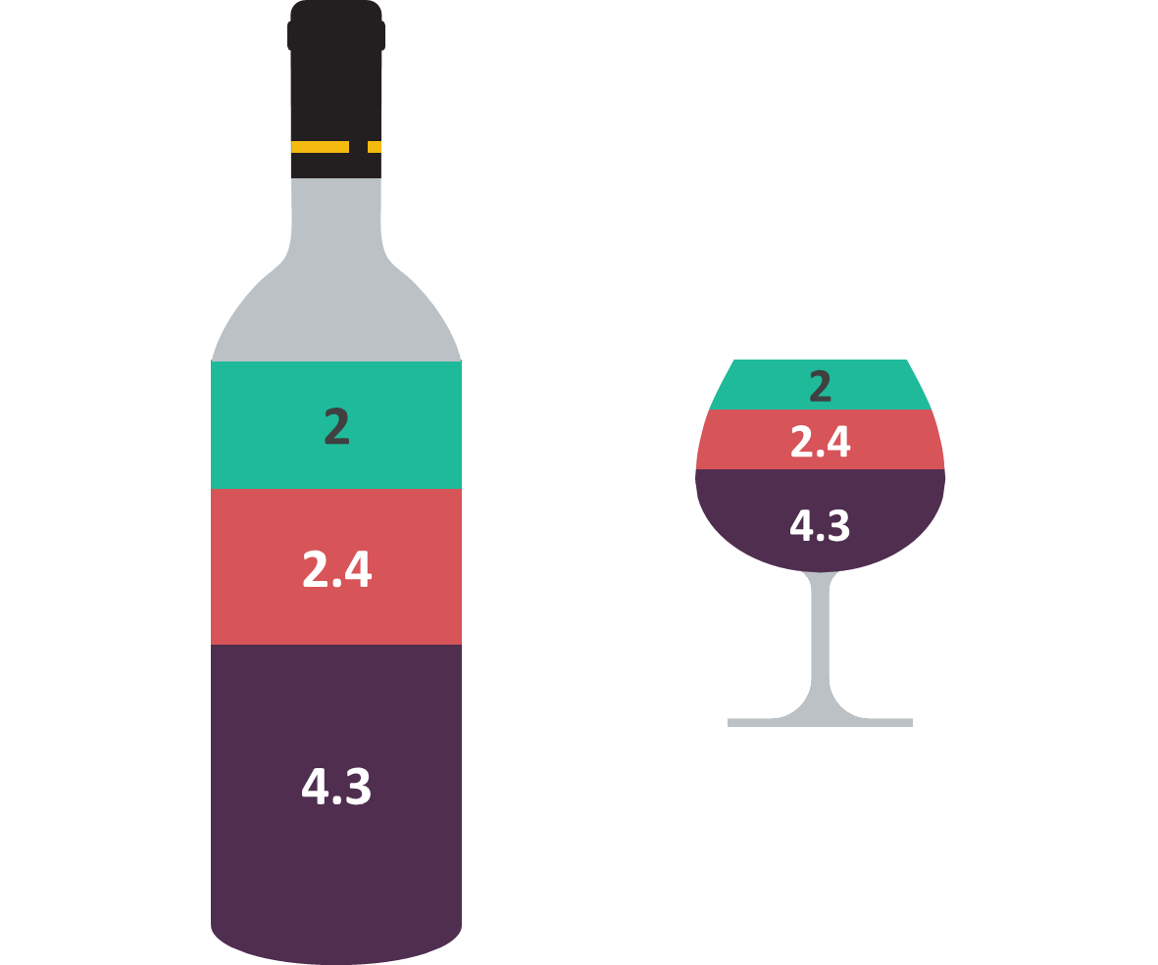
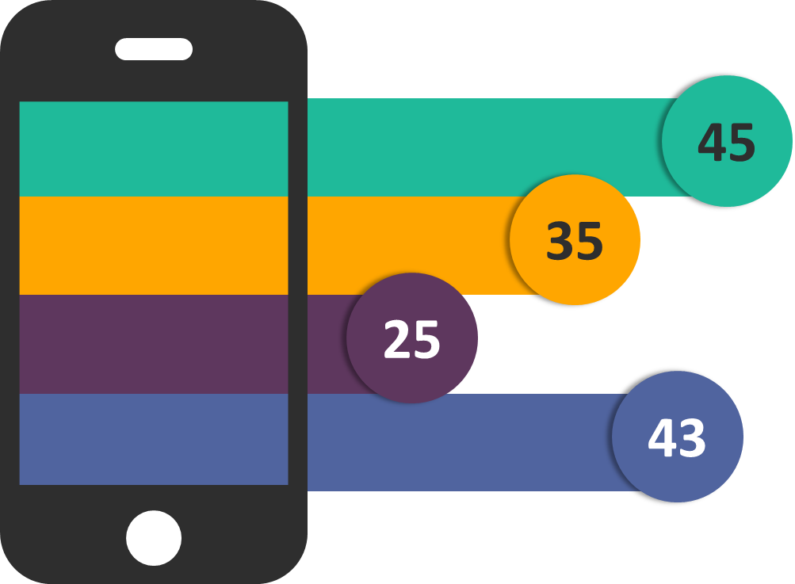
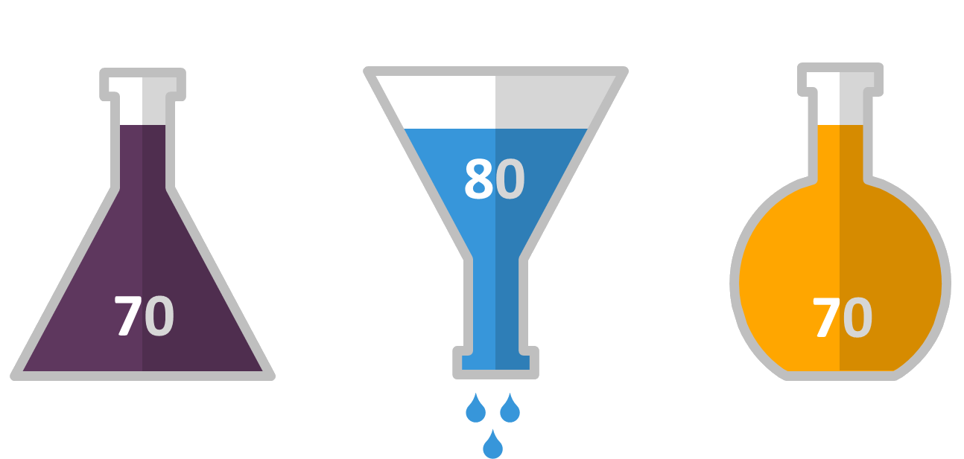
Charts & Infographics
Data-driven charts and editable shapes for PowerPoint
Notes:
© Copyright Showeet.com

Slide 2

01 – Simple charts 02 – Advanced charts 03 – Charts with “Male / Female” elements 04 – Column charts 05 – Bar charts 06 – Pie charts
Contents
Charts & Infographics
Notes:
© Copyright Showeet.com

Slide 3
Infographics - Simple Charts
01
Data-driven charts for PowerPoint
Charts & Infographics
Notes:
© Copyright Showeet.com

Slide 4
Infographics for PowerPoint – Pie Charts
Data-driven Pie Charts
Information 1
Information 2
Information 3

Slide 5
Infographics for PowerPoint – Pie Charts
Data-driven Pie Charts // Doughnuts
Information 1
Information 2
Information 3

Slide 6



Infographics for PowerPoint – Pie Charts
Data-driven Pie Charts // Doughnuts
Information 1
Information 2
Information 3

Slide 7

Infographics for PowerPoint – Pie Chart
Data-driven Pie Chart // Doughnut

Slide 8
Infographics for PowerPoint – Pie Chart
Data-driven Pie Chart // Doughnut

Slide 9
Infographics for PowerPoint – Pie Chart
Data-driven Pie Chart // Doughnut

Slide 10
Infographics for PowerPoint – Pie Chart
Data-driven Pie Chart // Doughnut

Slide 11
Infographics for PowerPoint – Progress Bars
Data-driven Column charts

Slide 12
Infographics for PowerPoint – Stacked Bars
Data-driven Bar charts
Information 1
Information 2
Information 3
Information 4

Slide 13
Infographics for PowerPoint – Bars
Data-driven Bar chart
13

Slide 14
Infographics – Advanced Charts
02
Data-driven charts for PowerPoint
Charts & Infographics
Notes:
© Copyright Showeet.com

Slide 15

Infographics for PowerPoint – Radial Chart
Data-driven Pie Chart
Tip:
Overlay as much pie-charts as needed

Slide 16
Infographics for PowerPoint – Radial Chart
Data-driven Pie Chart

Slide 17
Infographics for PowerPoint – Radial Chart
Data-driven Pie Chart

Slide 18
Infographics - Male / Female
03
Data-driven charts for PowerPoint
Charts & Infographics
Notes:
© Copyright Showeet.com

Slide 19
Infographics for PowerPoint – Female Vs. Male
Data-driven Stacked Column Chart
Female
Male
Tip:
Uses editable shapes as layers ;
the chart is sent to back

Slide 20
Infographics for PowerPoint – Female Vs. Male
Data-driven Stacked Column Chart
Female
Male
70%
50%
Tip:
Uses editable shapes as layers ;
the chart is sent to back

Slide 21
Infographics for PowerPoint – Female Vs. Male
Data-driven Bar Chart
Female
Male
Tip:
Uses editable shapes as layers ;
the chart is sent to back

Slide 22
Infographics for PowerPoint – Female Vs. Male
Data-driven Bar Chart
Female
Male
1st technique:
Uses editable shapes as layers

Slide 23
Infographics for PowerPoint – Female Vs. Male
Data-driven Bar Chart
Female
Male
2nd technique:
Chart with picture fills

Slide 24
Infographics - Column Charts
04
Data-driven charts for PowerPoint
Charts & Infographics
Notes:
© Copyright Showeet.com

Slide 25
Infographics for PowerPoint – Hourglass Diagram
Data-driven Column Chart

Slide 26
Infographics for PowerPoint – Wine Diagram
Data-driven Column Charts

Slide 27
Infographics for PowerPoint – Chemistry Diagrams
Data-driven Column Charts

Slide 28
Infographics for PowerPoint – Thermometer Diagram
Data-driven Column Charts

Slide 29
Infographics for PowerPoint – Bubble Diagram
Data-driven Column Charts

Slide 30
Infographics for PowerPoint – Cellular
Data-driven Column Chart

Slide 31
Infographics for PowerPoint – Funnel Diagram
Data-driven 100% Stacked Column Chart

Slide 32
Infographics for PowerPoint – Pyramid Diagram
Data-driven 100% Stacked Column Chart

Slide 33
Infographics for PowerPoint – Column Diagram
Data-driven Column Chart
Information 1
Information 2
Information 3
Information 4

Slide 34
Infographics for PowerPoint – Coins Diagram
Data-driven Column Chart
Information 1
Information 2
Information 3
Information 4

Slide 35
Infographics for PowerPoint – Pills Diagram
Data-driven Column Chart
Information 1
Information 2
Information 3
Information 4

Slide 36
Infographics for PowerPoint – Battery (w/ levels) Diagram
Data-driven Column Chart
Information 1
Information 2
Information 3
Information 4

Slide 37
Infographics for PowerPoint – Battery Diagram
Data-driven Column Chart
Information 1
Information 2
Information 3
Information 4

Slide 38
Infographics - Bar Charts
05
Data-driven charts for PowerPoint
Charts & Infographics
Notes:
© Copyright Showeet.com

Slide 39
Infographics for PowerPoint – Cellular
Data-driven Bar Chart
45
35
25
43

Slide 40
Infographics for PowerPoint – Laptop
Data-driven Bar Chart

Slide 41
Infographics for PowerPoint – Banner Diagram
Data-driven Bar Chart
Information 1
Information 2
Information 3
Information 4

Slide 42
Infographics for PowerPoint – Bar Diagram
Data-driven Bar Chart
Information 1
Information 2
Information 3
Information 4

Slide 43
Infographics for PowerPoint – Coins Diagram
Data-driven Bar Chart
Information 1
Information 2
Information 3
Information 4

Slide 44
Infographics for PowerPoint – Pills Diagram
Data-driven Bar Chart
Information 1
Information 2
Information 3
Information 4

Slide 45
Infographics for PowerPoint – Battery (w/ levels) Diagram
Data-driven Bar Chart
Information 1
Information 2
Information 3

Slide 46
Infographics for PowerPoint – Battery Diagram
Data-driven Bar Chart
Information 1
Information 2
Information 3

Slide 47
Infographics - Pie Charts
06
Data-driven charts for PowerPoint
Charts & Infographics
Notes:
© Copyright Showeet.com

Slide 48
Infographics for PowerPoint – Camera
Data-driven Pie Chart

Slide 49
Infographics for PowerPoint – Magnifying Glass
Data-driven Pie Chart

Slide 50
Infographics for PowerPoint – Chronometer
Data-driven Pie Chart

Slide 51
Infographics for PowerPoint – Chronometer
Data-driven Pie Chart
25’

Slide 52
Infographics for PowerPoint – Pentagon
Data-driven Pie Chart

Slide 53
Thank You!
Hope you like these templates :)
Notes:
© Copyright Showeet.com

Slide 54
http://www.showeet.com
https://www.facebook.com/pages/Neetwork/240707325947259
@showeet
http://pinterest.com/showeet
http://feeds.feedburner.com/showeet
© Copyright Showeet.com
http://www.showeet.com/terms-of-use/
http://www.showeet.com/fr/conditions-utilisation/
http://www.showeet.com/es/condiciones-de-uso/
Notes:
© Copyright Showeet.com

